Slide 1


H2O Co. Distilled Water Management System OPIM 5272: Business Process Modeling & Data Management
Team - 15
4/29/2021
1
Notes:
Hello everyone, this is Aishwary Bodhale from team 15 presenting our data management & business process modelling project.
The topic of our project is a Distilled water manufacturing and distribution company

Slide 2

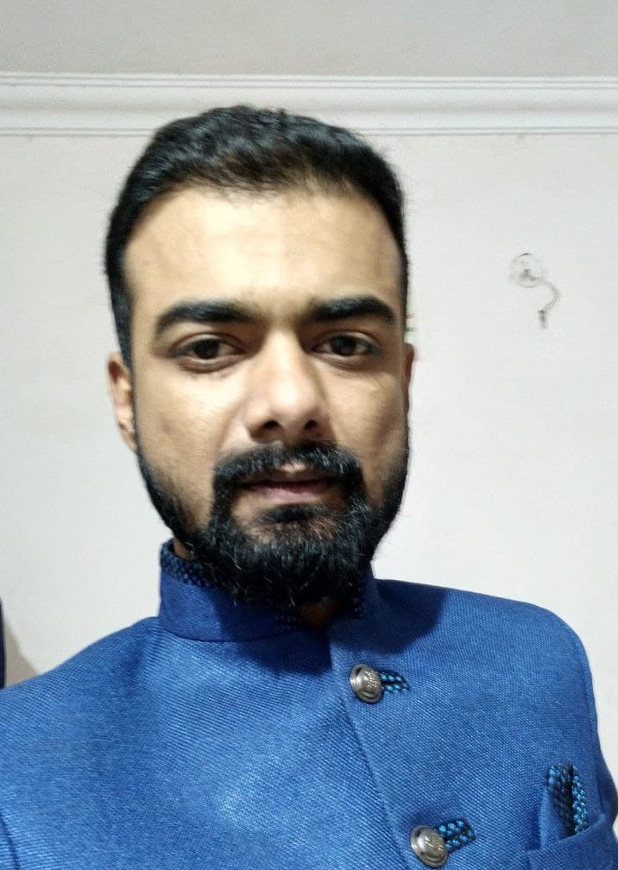


OUR TEAM
Aishwary Bodhale
Himanshu Dubey
Karishma Ramchandani
Nandan Adlakha
Notes:
Aishwary
Our Team, Team no. 15 comprises of me, Himanshu Dubey, Karishma Ramchandani and Nandan Adlakha.

Slide 3
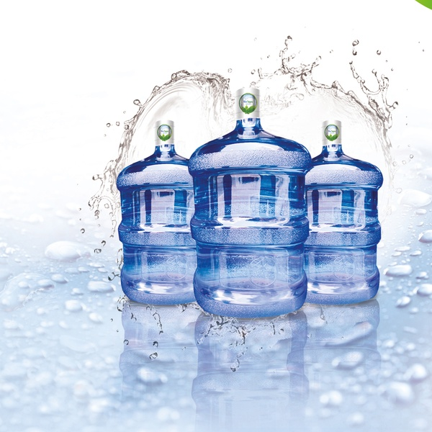
AGENDA
Introduction
Business Problem
Objective
Manual Process Flow
Process Flow “To be”
Database EERD
Database Demonstration
Benefits
Conclusion
Notes:
Aishwary
As you can see in the current slide, this is the agenda for our today’s presentation.

Slide 4
INTRODUCTION
H2O Co. is a distilled water manufacturing company which provides distilled water suitable to drink.
The quality of water is tested by a tester who checks it according to the water drinking standards.
After required quality checks, the water containers are delivered to customer’s address.
Notes:
Aishwary
H20 is a Distilled water manufacturing and distribution company, providing pure water to its customers which is suitable for drinking purposes as per the drinking water standards.To maintain the quality as per the standards, we have a special quality testing team with dedicated testers for each consignment. These testers make sure that the water is as per the drinking standards and hence deliver water of the highest possible quality standards. The distilled water is delivered to the customers at their doorstep.

Slide 5
BUSINESS PROBLEM
Manual tracking of existing process.
No repository for storing order data.
Tracking orders, maintaining stock, quality of batches & customer feedback is a hassle.
To detect the batches not meeting the water quality standards.
Hard to eliminate human errors, resulting in losses to the company.
Notes:
Aishwary
Next is business problem we are addressing
One of the problems in the current manual system is that there is no repository of storing the order data or the details of the quality check. It becomes a hustle to track orders, to maintain stock, quality of batches and feedback of user/company.
If the company gives a big order it would be difficult to check the ordered detail and water containers required with expiration date and convey till the package is ready to transport. As the process is manual and with multiple orders, it becomes cumbersome to give estimated delivery date. Another case is if some water container fails the quality check, it is difficult to diagnose the cause in the absence of feedback from Quality Tester. If the data is properly maintained in the database, the mistakes can be minimalized, and further steps can be taken to reduce mistake in the distillation process. With well managed database, customers feedback can also be stored, and necessary steps can be taken as per feedback to improve the system. If the feedbacks are not implemented timely it can result to decrease of customers.
Another important problem is to track the transportation. Company receives many orders in a day so to keep a manual track of all the transportations would require much more man force. And in the manual process we could not eliminate human errors which would result to loss of the company. And to verify the quantity of the order, the expiration date, the quality check status before actually transporting the water to the customer requires collaboration between these teams, thus this process is time consuming when done manually.

Slide 6
OBJECTIVE
Automating the distilled water management system by creating a database.
Eliminate human errors in the existing manual process.
Target areas where business can be expanded.
To increase the productivity and improve the plant efficiency.
Notes:
Himanshu
The objective of introducing DBMS in distilled water management system is to provide an environment that is both convenient and efficient to use in retrieving and storing data base information.
With database, it becomes more accessible and integrated with the rest of our work. It will also help us in reducing human errors in existing manual process
Managing information using a database allows us to become more strategic and target areas or customer where business can be expanded.
With the database, a systematic way can be developed to operate, maintain, upgrade and dispose of data in the most cost-effective manner including all costs, risks and performance attributes, which in return will increase the productivity and improve the plant efficiency.

Slide 7
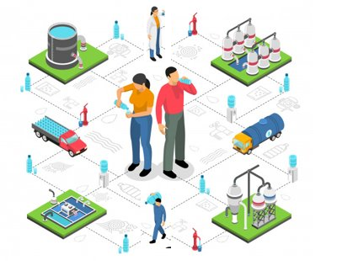
MANUAL PROCESS FLOW
Passed water container
Tester tests the water quality
Water containers delivery
Water filled in water containers
Customer places order
Order received by Admin
Distilled water manufacturing system
Notes:
Himanshu
The plant comprises of different departments like office for administrative work, water manufacturing system, filling of distilled water in water containers, a quality check department to check the quality of water, water container inventory and delivery process.
The slide shows manual process flow, the company receives an order from the customer, either from an individual or a company, the order received by the admin which includes all the details related to the order. Further, the water containers are checked by the tester as per the drinking water standards and if passed, the water containers are stored in inventory and according to the delivery dates, the water containers are delivered to the shipping address.
The problem with the current manual system is there is no proper order tracking, inventory and resource management, and no feedback of the service.

Slide 8
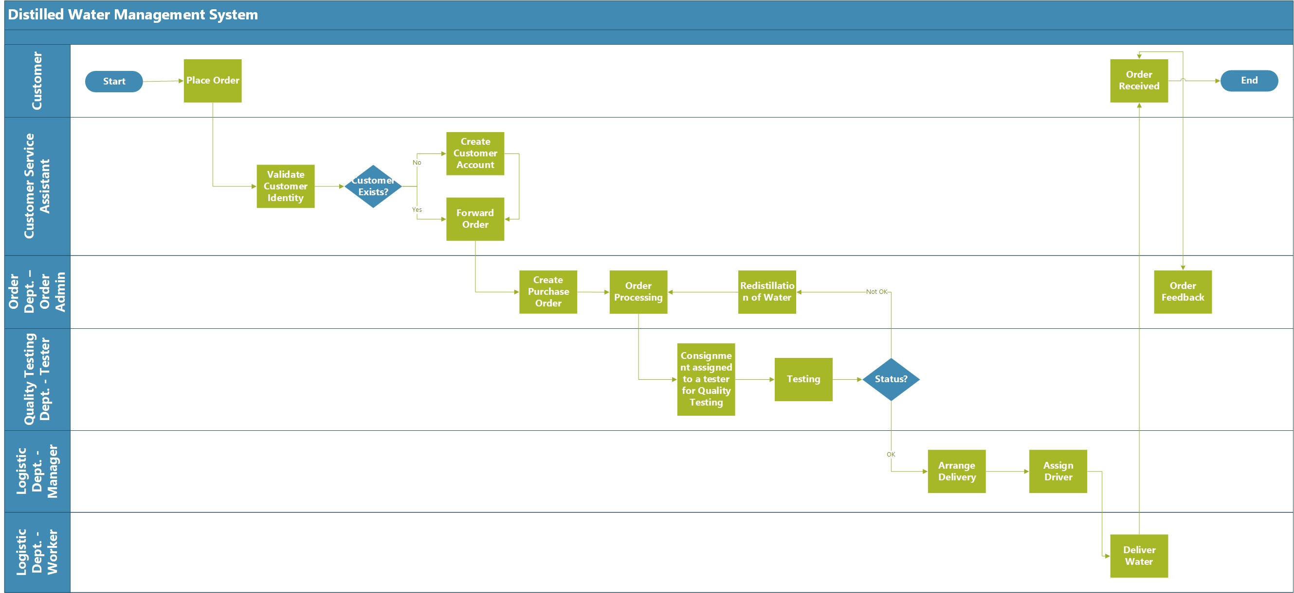
100%
PROCESS FLOW “TO BE”
Notes:
Himanshu
The process flow to be is shown with the swim lane diagram, it has 6 actors' customer, customer service, assistance, order department- order admin, quality testing department, logistic department manager and logistic department worker. As the order is placed by the customer, the customer service assistance validate the customer identity and if the customer exists the decision is made, and the process moved to order dept. For a new customer a new account is made. The order is further moved to quality testing department and if the water quality meet the drinking quality standards, the water containers are made ready for the delivery. If the status of water is marked as not ok by the tester, the water is sent back to the redistillation process. The customer receives the order and gives feedback.

Slide 9
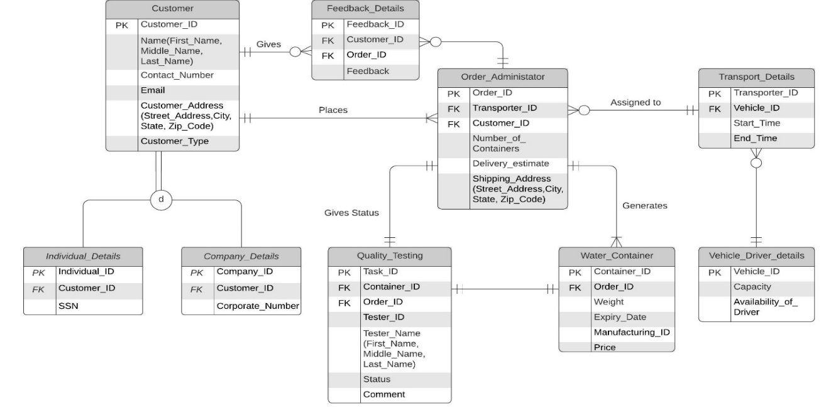
100%
DATABASE EERD
Notes:
Himanshu
A customer, either an individual or a company can place one or more order and upon receiving an order, an order ID is generated in the system which includes all the details related to order like number of containers, delivery estimate and shipping address.
The admin assigns a unique order id to all water containers and feed other container details like manufacturing ID, weight, price, expiry date. The quality of water is tested by a tester who checks it according to the water drinking standards and passes the order by marking the status. One container is equivalent to one task. A tester may have more than one task.
If the tester marks the status as OK, the admin assigns it to a transporter where vehicle and transport details are maintained. If the tester marks the status as NOT OK, then the container again goes to the process of distillation and the distillation is done as per comments given by tester.
Once the container reaches the user, the user can give feedback about the quality of water or the process. This feedback is monitored by the admin to improve the process which in turns improves customer satisfaction.

Slide 10

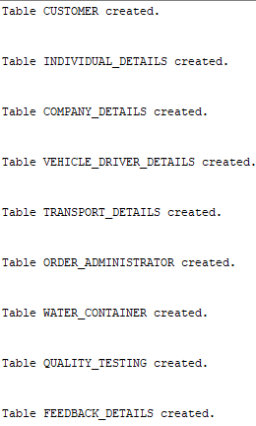
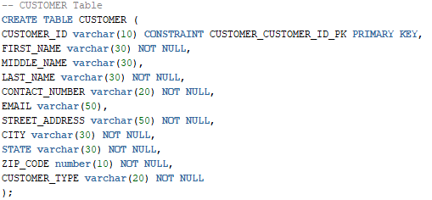
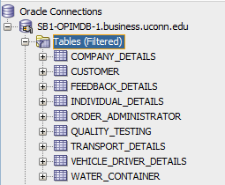
DATABASE DEMONSTRATION
Table Creation :
9 Tables Created
Notes:
Karishma
Now I’ll be demonstrating how we implemented the Database in our project.. As you can see from the EERD We have a created total of 9 tables such as the Customer table which will store personal information of the customers. These tables have primary key and foreign key constraints linking the tables, so that data can be retrieved later from multiple tables.
Now customer can be of two types either Individual or Company. We have created two subtypes to represent this condition.
Further we have Order Administration Table which will contain Order details of each order. We also have water container table which stores container details such as ID , expiry date, etc. After this we have Quality testing table which stores status of each container tested and comments.
We have Transport Details and Vehicle driver details which contains transportation details of each order, who is the driver, vehicle ID and carrying capacity of the vehicle, destination of the order, etc.
At last, we also have Feedback table which will store feedback given by customers if any for the order received.

Slide 11
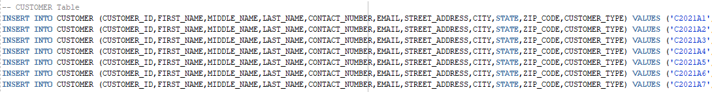
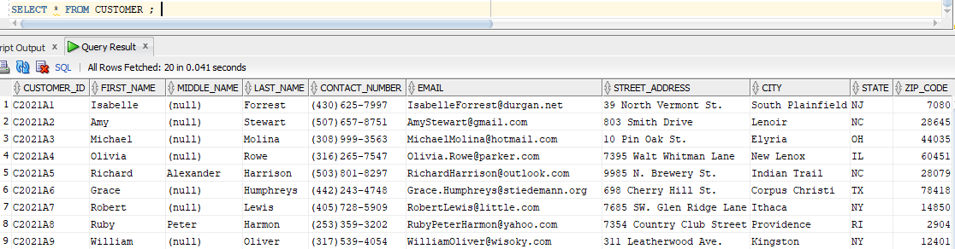
DATABASE DEMONSTRATION
Data Insertion :
Minimum of 20 records added in all tables
Notes:
Karishma
For demonstration purpose we added dummy records in all the tables.
This demo data contains orders for the month of April.
For example, as you can see for the customer table this is how we added records in each table following the protocol of constraints.

Slide 12
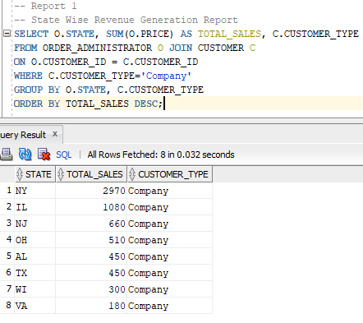
DATABASE DEMONSTRATION
SQL Report 1:
Report for State Wise Revenue Generation
Notes:
Karishma
Now we will see how this database can be beneficial for business.
This report shows state wise revenue generation .This report is obtained by applying join on Order administrator and customer table.
We will know which state has maximum sales. This will help the company to plan, market and increase sales in such states and identify the root cause for less sales in other states. This can also help in expanding business by opening a new warehouse in the states having maximum sales, as a result increasing the company’s overall generated revenue.

Slide 13
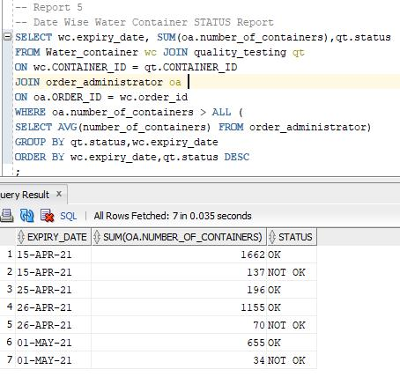
DATABASE DEMONSTRATION
SQL Report 2:
Date Wise Testing Status Report Of Water Containers
Notes:
Karishma
In this report we have Date Wise Testing Report of Water Containers. This report is created by applying a join on the Water Container and quality testing tables.
This report will help us conducting a survey of containers that meet or do not meet the drinking quality standards on a particular day, and according to that take informed decisions such as process improvements or other amendments needed to improve the overall efficiency of the distillation process.

Slide 14
BENEFITS
Enhanced access and management of data
Better visibility of the organization's operations
Easy tracking and management of orders
Improved order delivery system and satisfied customers
Feedback management system
Notes:
Nandan
Benefits
An advantage of the database in the Distilled Water Manufacturing System is that it helps to create an environment in which the admin can have better access to more and better-managed data.
With wider access to well-managed data, they will have an integrated view of the organization’s operations and a clearer view of the bigger picture. It becomes much easier to see how actions in one segment of the company affects another segment.
Better-managed data and improved data access makes it possible to generate better-quality information, based on which better and well-informed decisions can be taken. For Example, for each container of water the Quality Tester can feed comments and give reason for approval or disapproval of quality check which will further decrease the number of disapproved batches.
The availability of data, combined with the tools that transform data into usable information can help the organization to track each detail of order, ensuring timely delivery of the orders and satisfied customers.
The feedback system which was not in place earlier has also been implemented now, ensuring that customer grievances if any are resolved. This will also ensure that if any process improvements or amendments are needed, they are taken into consideration accordingly.

Slide 15
CONCLUSION
Increase in revenue, better manpower management, order tracking, better utilization of resources and plant capacity
Business expansion based on maximum revenue generated in a state.
Reduction in transportation cost
Better tracking & analysis of batches not meeting the water quality standards
Notes:
Nandan
Conclusion
The business would be benefitted overall with increased revenue, better utilization of the resources, better efficacy of the distillation process, better management of manpower, efficient order tracking system and better utilization of the overall plant capacity.
The report showing maximum revenue generated per state could be leveraged in setting up a new warehouse based on the demand and thus would help in business expansion.
The report showing Insights for maximizing the utilization of delivery vehicles to their fullest capacity will help in reduction of transportation cost.
The report showing the status of quality testing of consignments per day will help in better tracking and analysis of batches not meeting the water quality standards. Based on this, business can take informed decisions such as process improvements or other amendments needed to improve the overall efficiency of the distillation process.

Slide 16
THANKS!
Any questions?
Notes:
Nandan

